Slide 1
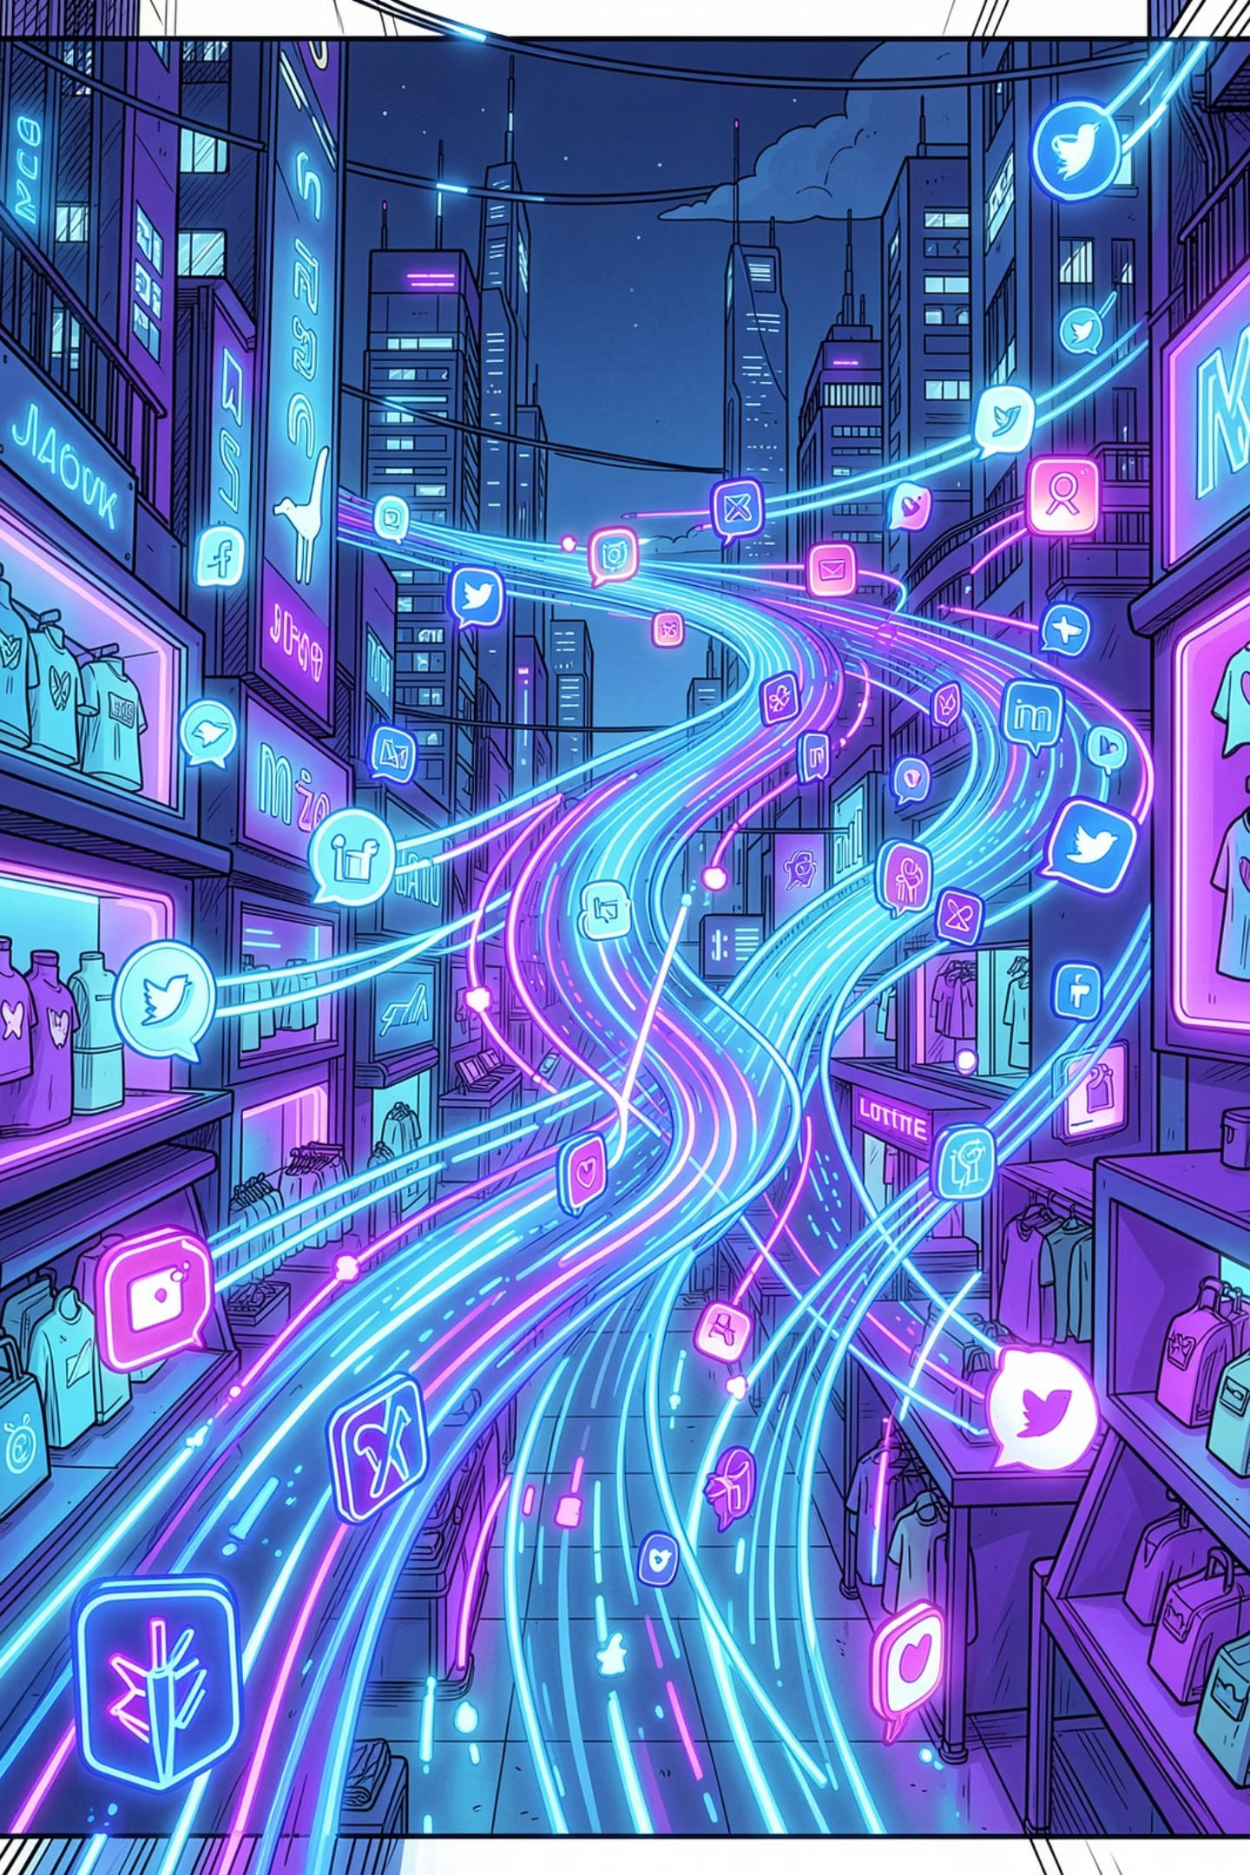
Real-Time Social Media Mining and Trust-Aware Sentiment Analysis
Using Large Language Models for Retail Feedback Optimization
BITS ZG628T · Dissertation
Faculty Mentor: Pradnya Kashikar
Supervisor: Varunendra Pratap Singh (Principal Software Engineer)
Candidate: Vishal Singh · 2024AA05641 · BITS Pilani
Program: MTech · AI & Machine Learning
Organization: Walmart Global Tech · GIF

Slide 2

What We're Building & Where We Are
An automated, trust-aware pipeline that tracks Walmart-related conversations on Reddit, uses LLMs to extract sentiment, aspects & emerging themes, and surfaces them in a human-reviewed dashboard so Ops · PR · Product teams can respond at social speed.
👂 01 · Listen
🧠 02 · Analyze
25 Walmart / retail subreddits · hourly · Arctic Shift API.
ModernBERT · DeBERTa-v3 · Gemma 3 vision · Trust score.
👁️ 03 · Review
🚀 04 · Act
Analysts validate, correct & prioritize in a Kanban board.
Route to PR · Product via P1 / P2 / P3 with SLAs, Post life cycle , inference for Walmart , review , replay etc .
✅ Part A · Mid-Semester
🟡 Part B · Post Mid-Semester
In progress
✓ End-to-end 6-stage pipeline (Ingest → Alert)
✓ Vision pipeline — Gemma 3 4B on image-only posts
✓ Trust score — Metadata · Dedup · LLM credibility
✓ ModernBERT fine-tune — Macro F1 0.76 (vs RoBERTa 0.63)
✓ Real-time dashboard — 22 API endpoints + WebSocket
✓ Notification system — P1/P2/P3 (Email · Slack · Teams) –SMTP & webhook finding out
☐ Review & Validate — Human-in-the-Loop workflow
☐ Post Explorer — Multi-facet filtering & search
☐ Kanban Lifecycle — Triaged → In-Review → Resolved
☐ Insights & Competitor — Cross-brand comparison
☐ Smart Reply Composer — Dual-draft (Rule + LLM)
☐ Learning loop — Feedback → future retraining
Overall Dissertation Progress Phase 1 of 2 · ~55% complete
Start
Final Defence
Project init, objectives defined
Complete pipeline and present findings
Mid-sem Checkpoint
Part A delivered — 55% complete

Slide 3
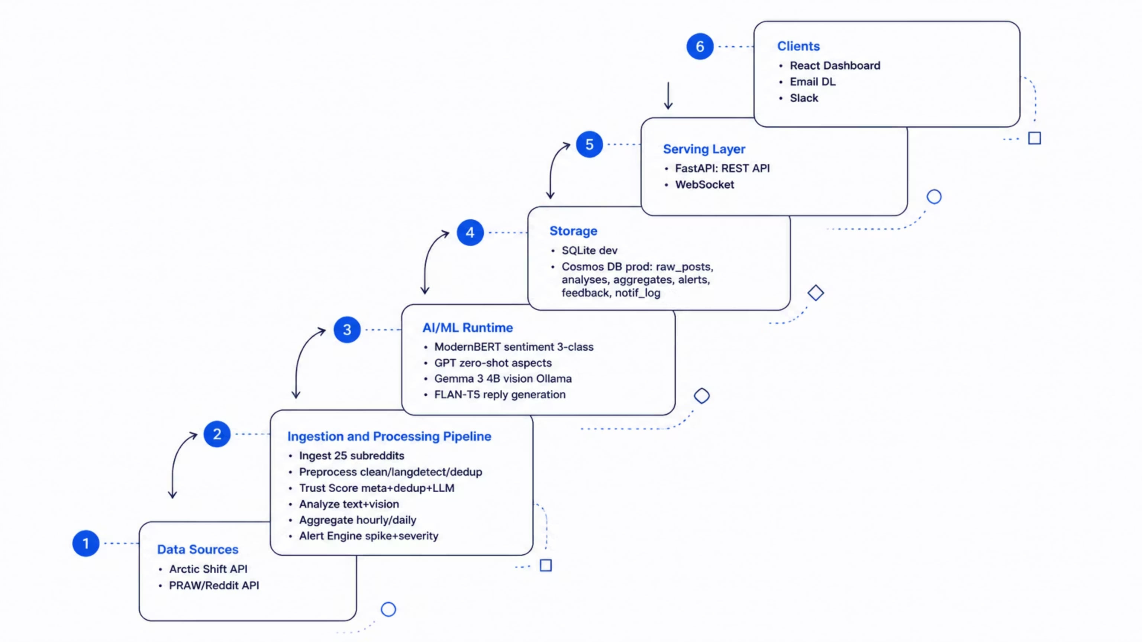
High-Level System Architecture
Layered view — external sources → pipeline core → AI runtime → storage → serving → clients

Slide 4
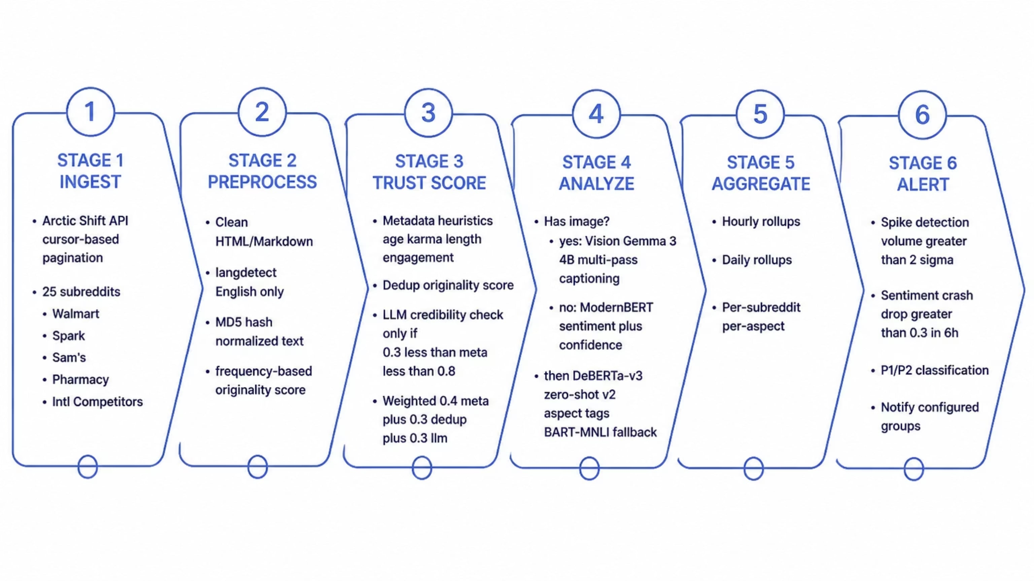
6-Stage Pipeline — Detailed Flow

Slide 5
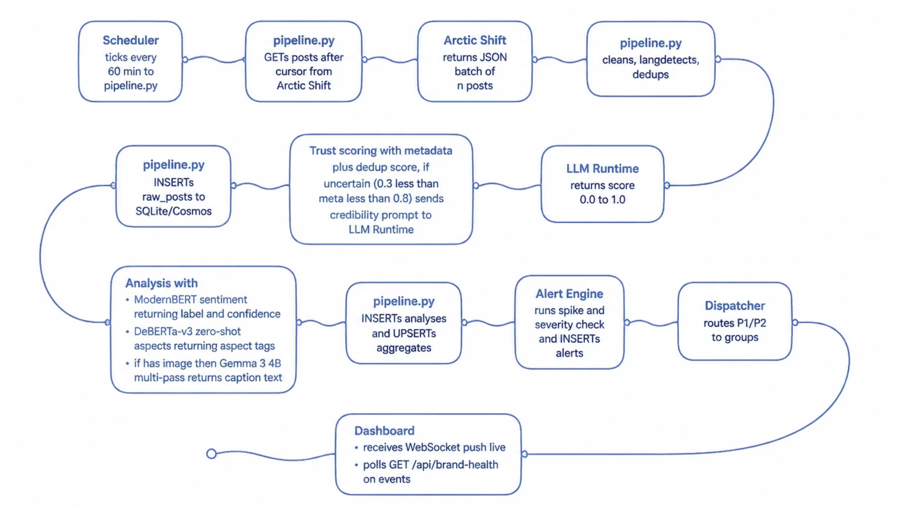
Request Sequence — End-to-End

Slide 6
Data Ingestion — Where the Plan Met Reality
How we replaced PRAW with the Arctic Shift API and turned a broken plan into a stable 60-minute ingestion loop
Initially Planned
Actually Shipped
🐍 PRAW · Reddit Dev API
🧊 Arctic Shift API
Official Python client for Reddit
OAuth-based, real-time listing & stream
Canonical "correct" ingestion path
Public Reddit archive endpoint — no auth
Windowed pulls across 25 Walmart-relevant subs
Same fetcher interface — PRAW pluggable later
❌ Blocker — could not secure working Reddit dev-API credentials in time (app-registration + auth-flow friction). Live streaming path parked.
✅ Mitigation — Arctic Shift keeps the pipeline unblocked. Zero downstream schema change; ingestion feeds the exact same raw_posts table.
Side-by-Side
Dimension
🐍 PRAW (planned)
🧊 Arctic Shift (shipped)
Auth
Reddit app + OAuth token
None — public HTTP
Access model
Live listings / stream
Windowed archive queries
Historical reach
~1 000 posts / listing cap
Deep — years of history
Setup effort here
Blocked at approval
Working same day
Cost
Free · quota-bound
Free · community-hosted
🎯 Outcome for the pipeline
No slippage — Stage 1 (Ingest) hits 25 subs · hourly in production.
Reversible choice — src/ingestion/ abstracts source; PRAW can slot in when credentials clear.
Bonus win — Arctic's historical depth let us backfill the benchmark set (200 real posts) that ModernBERT trained on.
Next in series → Step 2: Preprocess · Step 3: Trust · Step 4: Analyze · Step 5: Aggregate · Step 6: Alerts

Slide 7
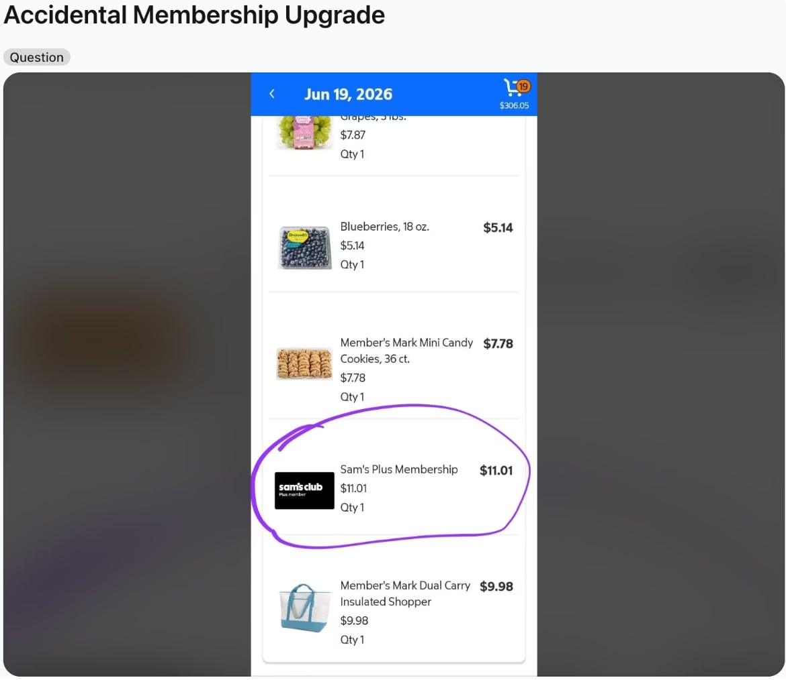
Vision Pipeline — Why Gemma 3 4B
39% of Reddit posts are image-only (empty body) — the complaint lives inside the image. Text-only pipeline drops these → we need a vision model to eliminate hallucination in multimodal retail analysis.
Example : Title: "Accidental Membership Upgrade"
↗ reddit.com/r/samsclub/comments/1uacdy7
Body: (empty) — the complaint is a purple circle drawn on the cart
❌ Text-only pipeline sees
Just the 3-word title. No item, no charge, no context. Sentiment ≈ neutral · Aspect = unknown. Silently dropped. Useless.
✅ Vision (Gemma 3 4B) extracts
Sam's Club app cart, Jun 19 2026 · total $306.05
Circled · Sam's Plus Membership $11.01 (purple ring = complaint anchor)
Other items ignored: Blueberries $5.14, Mini Candy Cookies $7.78, Insulated Shopper $9.98
Aspect = fees / accidental charges · Sentiment = negative · Conf 0.88
🎯 Signal recovered — a UX complaint about an easy-to-tap upgrade toggle now
feeds the fees aspect KPI and triggers alerts if the pattern repeats.
🧠 Vision model chosen
Best DocVQA under 4 GB — reads receipts, app screens
Google-maintained → Walmart policy compliant
Reuses local Ollama (localhost:11434)
4–6 s warm latency per image

Slide 8
Vision Pipeline · Deep-Dive — 75% Failure → Root Cause → Multi-Pass Fix
First-cut Gemma 3 4B hallucinated on 1 in 2 images → root-caused → 5 papers reviewed (all China-blocked) → borrowed the ideas → 4-pass pipeline with a text-only final step.
⚠️ 1 · First-cut test · n = 8 later with some more data n=25
🔍 2 · Root cause (5)
baseline single-pass
896 px fixed resize → small text unreadable
4 B params → can't reason button + error + context
No dynamic resolution → one fixed scale for whole image
Hallucinates under uncertainty → invents rather than admits
No context awareness → confuses screenshots vs physical displays
75% overall fail (6/8)
50% hallucination (4/8)
37.5% critical (fake receipts/prices)
25% correct (memes only)
Hallucinations seen: "receipt $39.99 w/ handwritten Damaged Box" (product page, no price, no handwriting) · "Order status PENDING" (word absent) · "12-pack Zero Sugar Dr Pepper" (single 42.3 fl oz regular bottle) → fabricated data corrupted dashboards.
📚 3 · Research 2023–25
🧭 4 · Strategy — take the ideas, not the models (same gemma3:4b, smarter calling)
5 / 5 blocked
Walmart vendor policy- Does NOT ALLOW China origin model
Paper technique
We implement as
❌ UReader (Tencent) — shape-adaptive cropping
❌ TextMonkey (USTC) — shifted window attention
❌ DocOwl 1.5 (Alibaba) — structure-aware parsing
❌ InternVL2 (Shanghai AI Lab) — tile-based
❌ Qwen2.5-VL (Alibaba) — dynamic res + multimodal RoPE
Tile-based processing (InternVL2)
Split image into 2–4 crops ourselves, send each to gemma3:4b
Structure-first parsing (DocOwl 1.5)
Pass 1 asks "what type of image?" before reading text
Focused text extraction (UReader)
"Read ALL text verbatim" prompt per tile
Consensus: tile-based attention + dynamic/native resolution is THE fix. Fixed resize is the failure mode — not the model architecture.
Resolution preservation (Qwen2.5-VL)
Tiling → 2–4× effective resolution without resizing
⚙️ 5 · Multi-pass pipeline (the fix)
PASS 1 · STRUCTURE
PASS 2 · TILE
DocOwl 1.5 →
"What TYPE?" → screenshot / photo / receipt / app / meme. Text-heavy → continue.
InternVL2 →
Split full image into 2–4 crops. Each crop = 2–4× effective resolution.
PASS 3 · EXTRACT
PASS 4 · MERGE (no image)
Ureader →
Per tile: "Read ALL text verbatim" → quoted text, prices, errors, buttons.
text-only LLM call →
Combine text observations into 2–4 sentences. Model never sees image → cannot lie.
Anti-hallucination insight: removing the image from the final generation step makes it physically impossible for the model to invent visual details — it can only work with text actually extracted in Pass 3.

Slide 9
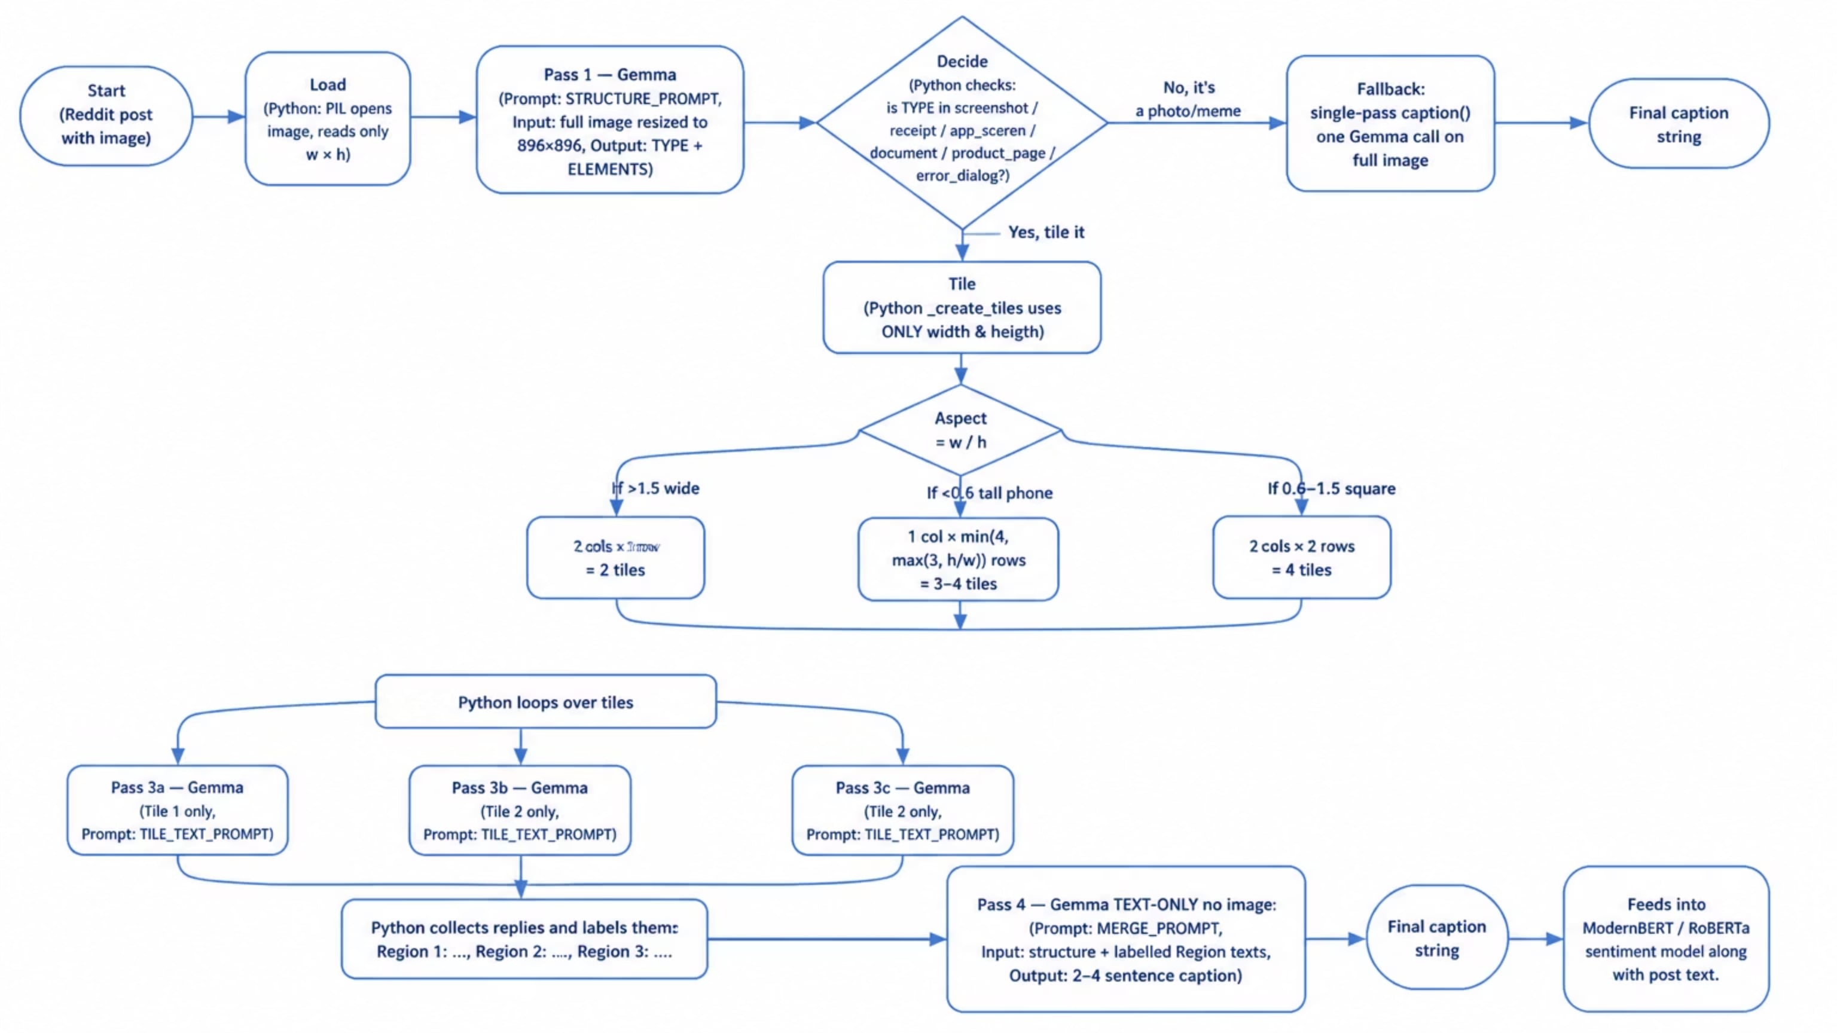
Reddit Image Pipeline python + Gemma

Slide 10
Trust Score — 3-Layer Credibility Filter
Not all Reddit posts are equal. A 10-year-old post from a 50k-karma user in r/walmart carries more signal than a 2-day-old account with 1 comment in r/walmart. We need a continuous trust score — not a binary filter — so downstream models and analysts can weight evidence appropriately.
Layer 1 · Metadata Heuristics
Layer 2 · Dedup / Originality
Layer 3 · LLM Credibility Check
Fast · no LLM · 40% weight
MD5 hash · frequency-based · 30% weight
Gemma 3 4B · gated · 30% weight
Account age (days since creation)
Comment karma (engagement history)
Post body length (effort signal)
Upvote ratio & comment count
MD5 of normalized text (lowercase, strip punctuation, collapse whitespace)
Count occurrences across 25 subs in rolling 7-day window
Score = 1.0 / count (unique = 1.0, seen 4× = 0.25)
Only runs if 0.3 < meta_score < 0.8 (uncertain zone)
Prompt: "Is this post credible? Consider specificity, emotional tone, factual claims."
Returns float 0.0–1.0
Skip if metadata already clear (saves ~4–6 s per post)
Final Score Formula
📊 Distribution (200-post benchmark)
🎯 Why it matters
Mean: 0.61
Std: 0.18
Skew: −0.3 (slight low-trust tail)
Low-trust posts → down-weighted in aggregates
High-trust + negative sentiment → P1 alert candidate
Analyst UI shows trust badge (🟢 / 🟡 / 🔴)
Feedback loop: analyst corrections → future LLM prompt tuning

Slide 11

ModernBERT-Based Sentiment Analysis for Walmart Reddit Posts
🎯 Business Challenge
Retail domain vocabulary gap: Generic models miss Walmart-specific terms like Cap-2, OGP, Pickup Associate, Coach, Store IDs, and Scan-and-Go, often misclassifying real complaints as Neutral.
Context-length limitation: BERT/RoBERTa models are limited to 512 tokens, so long Reddit threads and screenshot text get truncated and lose key sentiment signals.
➡️ Solution: Fine-tune ModernBERT-base into a 3-class sentiment classifier (Negative / Neutral / Positive) for Walmart Reddit content.
Why ModernBERT?
Dimension
Legacy Models
ModernBERT
Context window
512 tokens
8192 tokens
Inference speed
Slower inference
~2× faster
Long-thread handling
Often truncates posts and screenshots
Preserves more sentiment-bearing context
Training Setup
ModernBERT-base with ~150M parameters, a 2048-token sequence length, and coverage of >99% of Walmart Reddit posts.

Slide 12
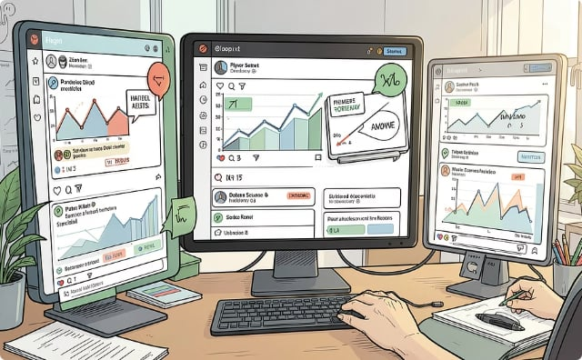
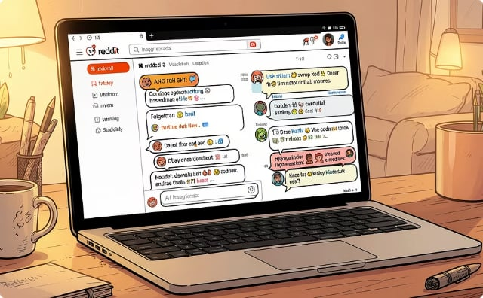
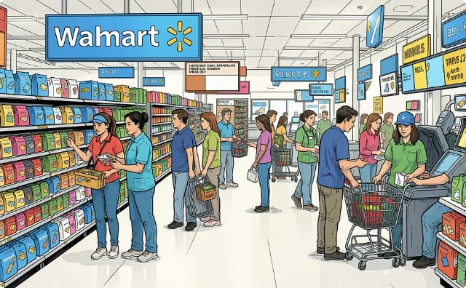
📚 Three-Stage Curriculum Learning
We had a large Walmart Reddit corpus, but only 200 posts were manually labeled. Training a 150M-parameter model directly on that small set would overfit, so we used a curriculum learning approach.
Stage 1 – General Sentiment Learning
Stage 2 – Reddit Language Adaptation
Stage 3 – Walmart Specialization
Walmart-200 Dataset
TweetEval Sentiment
GoEmotions Dataset
200 manually labeled Walmart Reddit posts
19 epochs
~45K labeled tweets
2 epochs
~43K Reddit comments
28 emotions collapsed into 3 sentiment classes
16 epochs
Objective: Learn Walmart-specific vocabulary and discussion patterns.
Objective: Teach basic positive, neutral, and negative sentiment recognition.
Objective: Learn Reddit-specific language patterns: slang, informal grammar, sarcasm, emotional expression.

Slide 13
🔄 5-Fold Cross-Validation (Maximum Learning from Limited Labels)
Why We Used It
Process
Manually labeling Walmart posts is time-consuming and requires human review and validation. Instead of reserving a large portion of the 200 labeled posts solely for testing, we used 5-fold cross-validation to maximize both training data utilization and evaluation reliability.
200 labeled posts → 5 stratified folds (40 posts each)
Class distribution preserved in every fold:
~63% Negative
~32% Neutral
~4% Positive
Fold1
Fold2
Fold3
Fold4
Fold5
40
40
40
40
40
Round 1
Round 2
Round 3
TEST Train Train Train Train → F1 = 0.71
Train TEST Train Train Train → F1 = 0.78
Train Train TEST Train Train → F1 = 0.72
Round 4
Round 5
Train Train Train TEST Train → F1 = 0.86
Train Train Train Train TEST → F1 = 0.61
Average Macro-F1
0.736 ± 0.115
For each fold, the model trained on 160 posts and tested on 40 unseen posts. This ensures every labeled post appears in the test set exactly once and is evaluated by a model that has never seen it.
✅ Each labeled post appears in the test set exactly once
✅ Each post is evaluated by a model that has never seen it
📈 Performance Results
0.63
0.736
0.764
Baseline Sentiment Models
Cross-Validation Mean F1
Out-of-Fold Macro-F1
± 0.115

Slide 14
⚙️ Training Details & Hyperparameters
Weighted loss is important: our Walmart-200 is roughly 63% negative / 32% neutral / 4% positive. A plain classifier would just predict 'negative' always and score 63% accuracy. We up-weight the rare classes so the model is forced to actually learn positive.
Base model
answerdotai/ModernBERT-base
~150M params, 8192 context
What 'loss = cross-entropy on logits' actually does during training
Learning rate
2e-5
Standard fine-tuning LR
Reads the tokens, produces 3 logits, e.g. [3.2, 0.9, 0.1].
Applies softmax → [0.87, 0.09, 0.04].
True label is negative (class 0). So loss = -log(0.87) = 0.14. Small loss = model was already right.
If true label had been positive (class 2), loss = -log(0.04) = 3.22. Huge loss = big kick.
Backpropagation adjusts every weight to make the correct class's probability larger next time.
Batch size
16–32
Fits on Apple M-series MPS
Multiply this over 88k training examples × 2 epochs (Stage 1+2) plus 200 × 10 epochs × 5 folds (Stage 3), and the model gradually rearranges its internal weights so Walmart complaints get high negative logits.
Max token length
2048
99% of Reddit posts
Loss
Weighted cross-entropy
Counter class imbalance
Early stopping
On macro-F1
Prevents overfitting
Optimiser
AdamW (Trainer default)
Standard for transformers
Seed
42
Reproducibility

Slide 15
Trust · Confidence Score — Model Certainty
Confidence = softmax probability of the predicted class.
How it's calculated
01
02
03
Logits
Softmax
Confidence
ModernBERT outputs logits for [negative, neutral, positive]
Softmax converts to probabilities: P(neg), P(neu), P(pos)
confidence = max(P(neg), P(neu), P(pos))
Thresholds used in the system
Threshold
Value
Source
Analysis confidence
≥ 0.7
config/models.yaml
Notification P1 trust
≥ 0.70 AND confidence ≥ 0.80
dispatcher.py
Notification P2 trust
≥ 0.50 AND confidence ≥ 0.60
dispatcher.py
Combined Priority Formula
P1 — Immediate Action
P2 — Review-Worthy
Below P2
P1 = (trust_score ≥ 0.70) ∧ (confidence ≥ 0.80) → immediate action
P2 = (trust_score ≥ 0.50) ∧ (confidence ≥ 0.60) → review-worthy
< P2 → no notification triggered (still visible in dashboard)
Dashboard displays both trust and confidence per post for analyst transparency.

Slide 16
Notification System — Architecture · Config Page · API
Group-based routing for P1 / P2 priority posts — email + Slack, per-team ownership
Priority classification & routing
P1 — trust ≥ 0.70 AND confidence ≥ 0.80 → immediate action
P2 — trust ≥ 0.50 AND confidence ≥ 0.60 → review-worthy
Routing model: per-subreddit-set — different teams own different subreddits
Each group has its own email DL, Slack channel, and priority filter (P1, P2, or both)
Pipeline → classify_priority(trust, conf)
├── Not P1/P2 → skip
└── P1 / P2 → find matching notification groups
├── group matches subreddit + priority filter?
│ ├── email DL configured → send email
│ └── Slack channel configured → send Slack
└── log to notification_log (audit trail)
Technical stack summary
Layer
Technology
Key decision
Backend
Python 3.13 · FastAPI · SQLite
Free · local-first · modular
Frontend
React 18 · TS · Vite · Tailwind
Modern SPA · responsive
Sentiment
ModernBERT (fine-tuned · 1024-tok)
Domain-specialized · offline
Aspects
DeBERTa-v3 zero-shot-v2 (BART-MNLI fallback)
No training needed
Vision
Gemma 3 4B via Ollama (multi-pass)
Policy compliant · no hallucination
Reply Gen
Mistral 7B (Ollama) + FLAN-T5-base (HF fallback) + Smart Composer
Dual draft · local-first · learning loop
Trust LLM
gpt-4o-mini via WMT LLM Gateway (ambiguous-zone only)
Cost-controlled cloud call · rule-based fallback
Trust · Scheduling · Observability
Metadata+Dedup+LLM · APScheduler 60 min + manual · structlog + JSONL cost ledger
Flag-don't-drop · cursor-based · per-call cost

Slide 17
Demo
Thank You
Vishal Singh

Slide 18
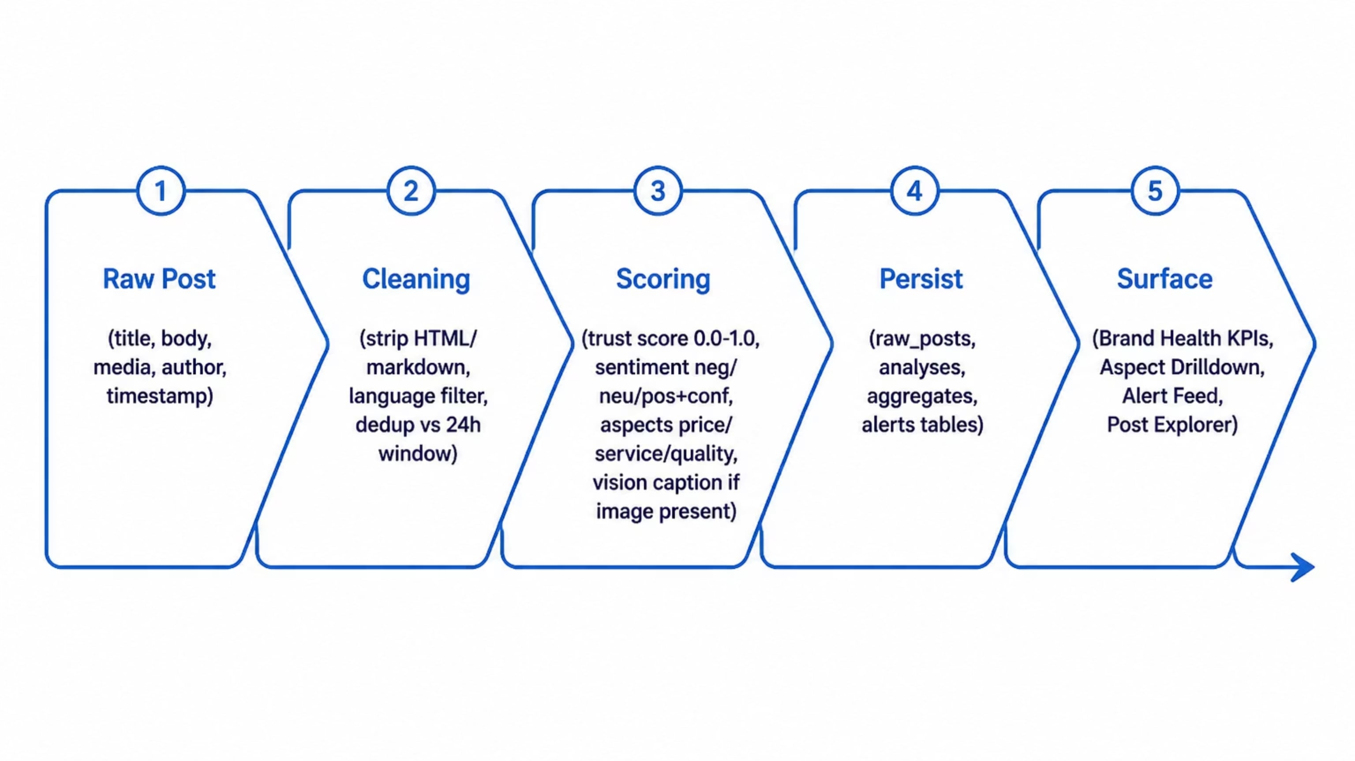
Data Flow — From Raw Post to Dashboard KPI
How a single Reddit post transforms into a scored, stored, and surfaced artefact

Slide 19
Example of one post to calculate the Trust and confidence Score -→ r/walmart
Post Metadata
Post Body
Author: u/tired_associate_2019
Title: "Store #4521 forced overtime again — 3rd time this month"
Score: 18 upvotes
Account age: 1830 days (~5 years)
Total karma: 3200
"Coach told our whole Cap-2 team we had to stay 2 hours past close for inventory. No approval, no notice. Third time. Register 7 was already down all evening. This is why associates are leaving."
Stage 1 — Trust Score
This step runs first in TrustScorer.score(unit).
1a. Metadata Score
1c. LLM Credibility
Weights: base=0.15, age=0.20, karma=0.20, length=0.30, engagement=0.15
Because the metadata score is above 0.8, the LLM step is skipped and the neutral default is used.
1
2
3
4
1b. Dedup Score
1d. Combined Trust
First appearance → dedup_score = 1.0. Later repeats are penalized.
Weights: metadata=0.4, dedup=0.3, llm=0.3
Signal
Raw
Formula
Score
Class
Logit
exp(logit)
Probability
Age
1830 days
min(1830/365, 1)
1.00
negative
3.20
24.53
0.87
Karma
3200
min(3200/5000, 1)
0.64
neutral
0.90
2.46
0.09
Length
259 chars
min(259/200, 1)
1.00
positive
0.10
1.11
0.04
Engagement
18 upvotes
min(18/20, 1)
0.90
Σ
28.10
1.00
metadata_score = 0.913
llm_score = 0.5
ModernBERT classifies the post as negative.
sentiment_label = "negative"
sentiment_confidence = 0.87
trust_score = 0.4 · 0.913 + 0.3 · 1.000 + 0.3 · 0.500
= 0.815
trust_score = 0.815

Slide 20

Stage 2 — Confidence Score
ModernBERT classifies the post as negative.
Class
Logit
exp(logit)
Probability
negative
3.20
24.53
0.87
neutral
0.90
2.46
0.09
positive
0.10
1.11
0.04
Σ
28.10
1.00
sentiment_label = "negative"
sentiment_confidence = 0.87
Stage 3 — Gate 1
Stage 4 — Priority for Notifications
gate_formula = "score_x_confidence" · gate_tau = 0.30
Thresholds: P1 = trust ≥ 0.70 and confidence ≥ 0.80; P2 = trust ≥ 0.50 and confidence ≥ 0.60.
gate = trust_score × sentiment_confidence
= 0.815 × 0.87
= 0.709
Tier
Trust ≥
Confidence ≥
P1
0.70
0.80
P2
0.50
0.60
0.709 ≥ 0.30 → passes, so the post is stored and eligible for alerts.
skip
else
else
If the score were below 0.30, the post would be marked low-trust and excluded from alerts, while still appearing on the dashboard.
Check: trust 0.815 ✓ · confidence 0.870 ✓
→ Priority = P1 → sends Slack + Email to matching notification groups.

Slide 21

📊 Results & Performance Comparison
RoBERTa Baseline vs. ModernBERT Performance
Model
max_len
macro-F1
F1 (neg)
F1 (neu)
F1 (pos)
Latency
RoBERTa baseline
512
0.627
0.797
0.609
0.476
6.5 ms
ModernBERT (ours)
2048
0.764
0.878
0.748
0.667
11.9 ms
Key Highlights
+13.7 macro-F1 points — a large gain, especially on positive (+19 points) which is the hardest and rarest class.
On the 7 long posts (≥512 tokens) that RoBERTa had to truncate, ModernBERT scores macro-F1 = 1.0 vs RoBERTa's 0.28 — direct evidence that the 8192-context matters.
CV mean = 0.736 ± 0.115 — the ±0.115 is honest, our 200-post benchmark is small so folds vary.
Per-Class Breakdown
Class
TP
FP
FN
Precision
Recall
F1
negative
115
20
12
0.852
0.906
0.878
neutral
46
12
19
0.793
0.708
0.748
positive
5
2
3
0.714
0.625
0.667
Final Metrics
Macro F1 = (0.878 + 0.748 + 0.667) / 3 = 0.764
Micro F1 = 166/200 = 0.83 (equals accuracy)

Slide 22
Training config
max_length = 1024 (long-context lever)
Effective batch 32 (BS 8 × grad-accum 4)
Class weights neg 0.52 · neu 1.03 · pos 8.33
Minority oversample to ~100/class/fold
🏆 Final results — 5-fold OOF CV
Metric
RoBERTa
ModernBERT v2
Δ
Macro F1 (overall)
0.6272
0.7642
+0.137 (+22%)
F1 negative
0.7967
0.8779
+0.081
F1 neutral
0.6087
0.7480
+0.139
F1 positive
0.4762
0.6667
+0.190
Long-post F1 (≥ 512 tok)
0.2778
89.879
+0.722
✨ Short-post F1 (n = 193)
0.6360
0.7619
+0.126
Latency (ms/post, MPS)
6.5
11.9
+5.4
Long-context hypothesis proven: on posts ≥ 512 tokens, ModernBERT scores a perfect 89.879 vs RoBERTa's 0.28.

Slide 23
ModernBERT · Training Evidence
Why not just use RoBERTa? — Decision matrix after
Criterion
RoBERTa (cardiffnlp/twitter-roberta-base)
ModernBERT (answerdotai/ModernBERT-base)
Winner
Context length
512 tokens
8192 tokens (16×)
ModernBERT
Training corpus
Twitter (short, casual)
Web + code + long docs
ModernBERT
Long-post F1 (≥512 tok)
0.2778
94.332
ModernBERT
Overall Macro F1
0.6272
0.7642
ModernBERT
Latency (MPS)
6.5 ms
11.9 ms
RoBERTa
Off-the-shelf quality
Strong baseline
Weak without fine-tuning
RoBERTa
Fine-tuning cost
Same
Same
Tie
Decision: ModernBERT wins on the metrics that matter (accuracy + long-context). We accept +5 ms latency for +0.137 macro F1. RoBERTa is retained as fallback in config/models.yaml if the local checkpoint is missing.
Smoke test at integration time: 5/5 correct on first 5 real benchmark posts (model_used = models/modernbert_walmart/final)

Slide 24
Papers
# | Paper | Authors / Year | arXiv link
1 | UReader — Universal OCR-free Visually-situated Language Understanding | Ye et al. (Tencent), 2023 | https://arxiv.org/abs/2310.05126
2 | TextMonkey — An OCR-Free Large Multimodal Model for Understanding Document | Liu et al. (USTC), 2024 | https://arxiv.org/abs/2403.04473
3 | DocOwl 1.5 — Unified Structure Learning for OCR-free Document Understanding | Hu et al. (Alibaba DAMO), 2024 | https://arxiv.org/abs/2403.12895
4 | InternVL2 — Better than the Best | Chen et al. (Shanghai AI Lab + Tsinghua), 2024 | https://arxiv.org/abs/2404.16821
5 | Qwen2.5-VL — To See the World with Wisdom | Alibaba Qwen Team, 2025 | https://arxiv.org/abs/2502.13923
Context length
512 tokens
8192 tokens (16×)
ModernBERT
Training corpus
Twitter (short, casual)
Web + code + long docs
ModernBERT
Long-post F1 (≥512 tok)
0.2778
94.332
ModernBERT
~/.cache/huggingface/hub/models--answerdotai--ModernBERT-base/.

Slide 25
Post Mid-Semester Work — Review · Explorer · Lifecycle · Insights · Results
All 5 areas built after mid-sem: human-in-the-loop workflows → competitor insights → consolidated metrics + tech stack
Review & Validate
Analysts correct AI labels + draft replies.
Queue sorted by priority (P1 first)
Correct sentiment + aspects
Click "Generate Drafts" → dual draft
A Smart Composer — deterministic phrase pool + keyword extraction
B Reply LLM — Mistral 7B (Ollama, primary) · FLAN-T5-base (HuggingFace fallback)
Analyst picks → edit → post to Reddit
Learning loop: replies → feedback table → few-shot examples for future drafts (tone matching improves without retraining)
1
Post Explorer
Browse all analyzed posts with rich filtering.
2
Filters: sentiment · confidence slider · trust slider · subreddit (25) · aspect (8-label) · date (today/week/month/custom) · full-text
Aspects: pricing · product quality · customer service · store experience · online/app · delivery/pickup · returns · app_website
Card: title + excerpt · sentiment badge · confidence % · trust indicator · aspect tags · subreddit · time
Actions: Review · Add to Lifecycle · View Details · Reddit link
Post Lifecycle (Kanban)
4-state board with 2-step resolve modal.
TRIAGED → ACKNOWLEDGED → IN PROGRESS → RESOLVED
new P1/P2 → assigned → reply drafted → posted
3
Step 1: save action note + LLM-drafted reply → "Save & open Reddit" (copies + opens thread) OR "Resolve (no reply)"
Step 2: paste reply on Reddit → return → "Mark Resolved"
All transitions timestamp-logged → SLA tracking
Insights & Competitor
AI-generated strategic intelligence.
4
Issue Rankings — volume × severity × recency, per aspect, trend arrows (up/down)
Competitor Pulse — Walmart vs Costco / Target / Amazon, cross-mentioned posts, subreddit breakdown
LLM Summaries — weekly themes, suggested action items, emerging-topic detection (new clusters in ≥5 posts / 2 hrs)
Aspect Drilldown — 8-label taxonomy from config/models.yaml; per-aspect sentiment trend + volume + word cloud + representative posts

